Slide 1
STRESS ANALYSIS AND PLASTICITY

Slide 2
OVERVIEW
Use this motivation to understand Matt's code
In the future, we may want to reimplement in C++, for now, it is important to understand what's done
Estimate the stresses around a fracture and the limits of Elasticity.
When plasticity must be considered?
The hypostasis is: PLASTICITY CANNOT BE NEGLECTED IN MOST RESERVOIR GEOMECHANICAL APLICATIONS, ESPECIALLY WHEN THERMAL-FRACTURE IS CONSIDERED
Use our target application (next slide)

Slide 3
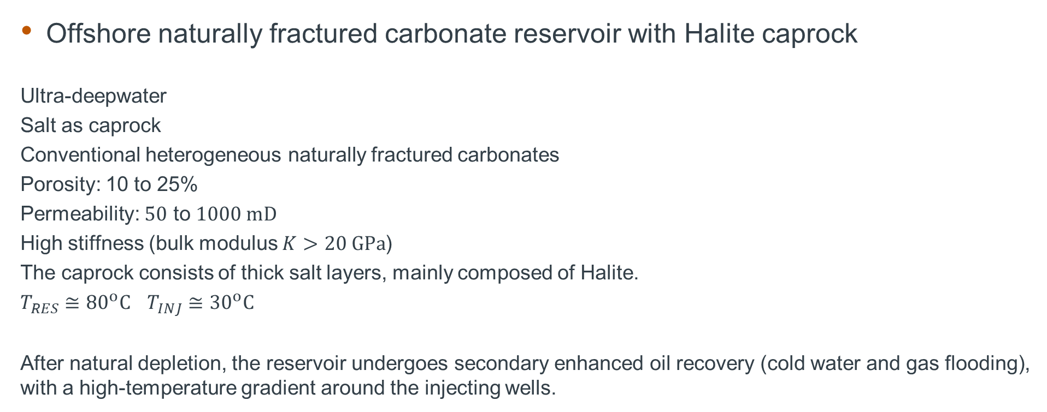
TARGET APPLICATION
Offshore naturally fractured carbonate reservoir with Halite caprock
Ultra-deepwater
Salt as caprock
Conventional heterogeneous naturally fractured carbonates
Porosity: 10 to 25%
Permeability: $50$ to $1000 mD$
High stiffness (bulk modulus $K>20 GPa$)
The caprock consists of thick salt layers, mainly composed of Halite.
$T_{RES}≅{80}^{o}C$ $T_{INJ}≅{30}^{o}C$
After natural depletion, the reservoir undergoes secondary enhanced oil recovery (cold water and gas flooding), with a high-temperature gradient around the injecting wells.

Slide 4
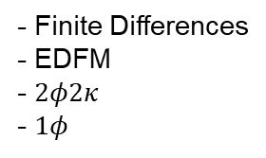
Methodology
Mechanics
Stress
Global mechanics
(U_{i})
Hydraulic
(P, S_{w}, S_{o}, S_{g})
P
- Finite Element
- Smeared
- Finite Differences
- EDFM
- $2φ2κ$
- $1φ$
Bound. Cond.
Fracture
Plasticity
(P, U_{i})
Effective params
T
P
Fracture propagation
(P, U_{i})
T
Thermal
(T)
- Finite Element
- Smeared
- Discrete
- Finite Differences

Slide 5
Methodology
Mechanics
Stress
Global mechanics
(U_{i})
Hydraulic
(P, S_{w}, S_{o}, S_{g})
P
- Finite Element
- Smeared
- Finite Differences
- EDFM
- $2φ2κ$
- $1φ$
Bound. Cond.
Fracture
Plasticity
(P, U_{i})
Effective params
T
P
Fracture propagation
(P, U_{i})
T
Thermal
(T)
- Finite Element
- Smeared
- Discrete
- Finite Differences

Slide 6
Methodology
Mechanics
Stress
Global mechanics
(U_{i})
Hydraulic
(P, S_{w}, S_{o}, S_{g})
P
- Finite Element
- Smeared
- Finite Differences
- EDFM
- $2φ2κ$
- $1φ$
Bound. Cond.
Fracture
Plasticity
(P, U_{i})
Effective params
T
P
Fracture propagation
(P, U_{i})
T
Thermal
(T)
- Finite Element
- Smeared
- Discrete
- Finite Differences

Slide 7
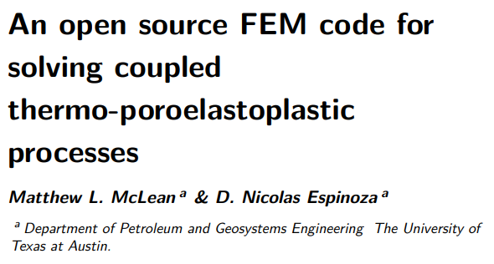
Implement plasticity solver
Plasticity
(P, U_{i})
Starting point: (McLean, 2024)
Re-implement and validate under libmesh (?)
Faster C++ implementation
Consider Enriched-Galerkin (Lee&Wheeler,2016)
Consider postprocessing filtering (Murad, 1994)
Apply to our target case (reservoir)
Include Creep
Apply to our target case (caprock)

Slide 8
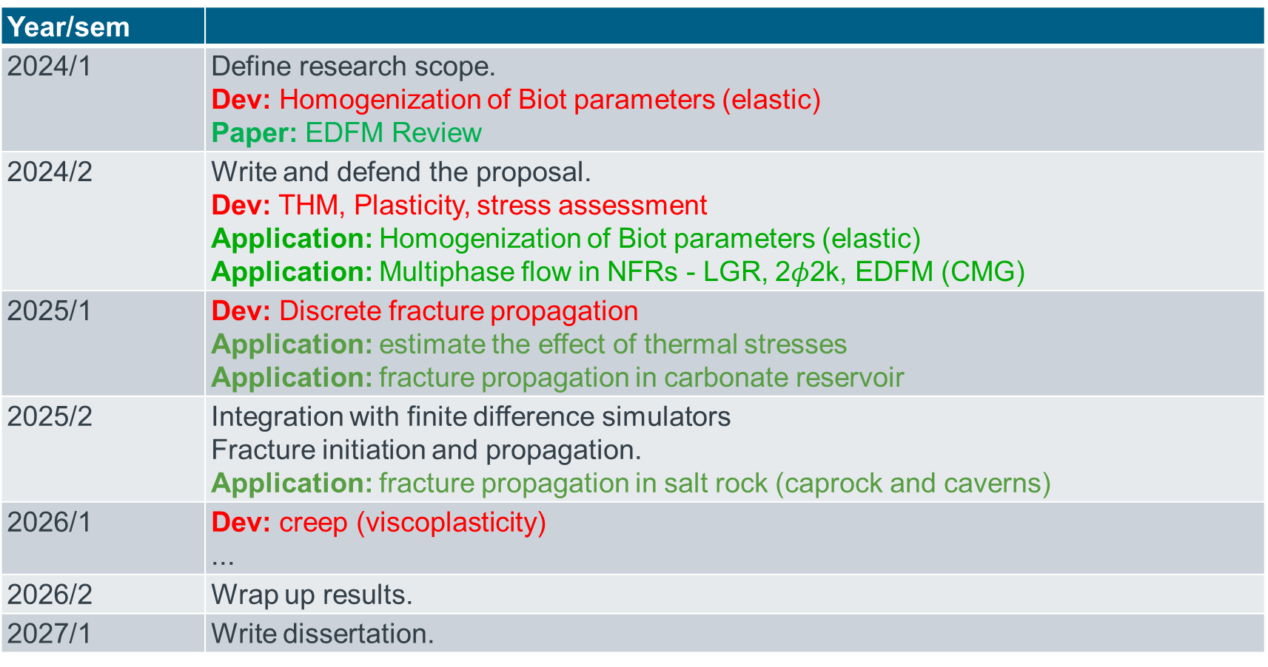
Timeline
Year/sem
2024/1 | Define research scope. Dev: Homogenization of Biot parameters (elastic) Paper: EDFM Review
2024/2 | Write and defend the proposal. Dev: THM, Plasticity, stress assessment Application: Homogenization of Biot parameters (elastic) Application: Multiphase flow in NFRs - LGR, 2$φ$2k, EDFM (CMG)
2025/1 | Dev: Discrete fracture propagation Application: estimate the effect of thermal stresses Application: fracture propagation in carbonate reservoir
2025/2 | Integration with finite difference simulators Fracture initiation and propagation. Application: fracture propagation in salt rock (caprock and caverns)
2026/1 | Dev: creep (viscoplasticity) ...
2026/2 | Wrap up results.
2027/1 | Write dissertation.

Slide 9
SOFTWARE LICENSE

Slide 10
SOME OPEN SOUCE LICENSES
PETSC
BSD - Berkely Software Distribution
LIBMESH
LGPL - Lesser GPL
FeniCS
Creative Commons Zero (CC0)
From the above, LGPL is the most restrictive, but can be used in commercial implementation.

Slide 11
Wikipedia comparison
License | Author | Latest version | Publication date | Linking | Distribution | Modification | Patent grant | Private use | Sublicensing | TM grant
BSD License | Regents of the University of California | 3.0 | ? | Permissive^{[14]} | Permissive^{[14]} | Permissive^{[14]} | Manually^{[14]} | Yes^{[14]} | Permissive^{[14]} | Manually^{[14]}
Creative Commons Zero | Creative Commons | 1.0 | 2009 | Public Domain^{[15][16]} | Public Domain | Public Domain | No | Public Domain | Public Domain | No
GNU Lesser General Public License | Free Software Foundation | 3.0 | June 2007 | With restrictions^{[31]} | Copylefted^{[26]} | Copylefted^{[26]} | Yes^{[32]} | Yes | Copylefted^{[26]} | Yes^{[32]}
https://en.wikipedia.org/wiki/Comparison_of_free_and_open-source_software_licenses

Slide 12
REFERENCES

Slide 13
